Slide 1

Instant Coffee
Consumer Analysis

Slide 2
Data: Transaction level
Aggregation by
- week
- household
- brand
Price elasticities
Buying behaviours
- loyalty
- promotion

Slide 3
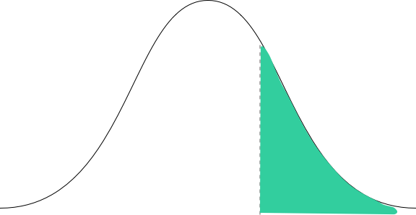
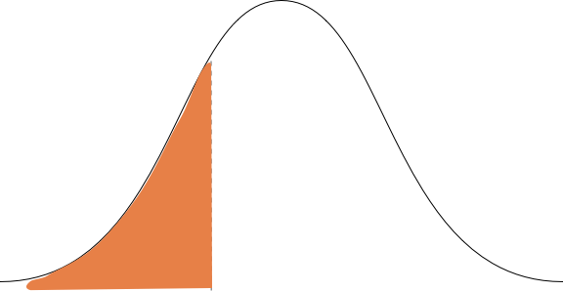
Consumer segments
Heavy consumer
Light consumer

Slide 4
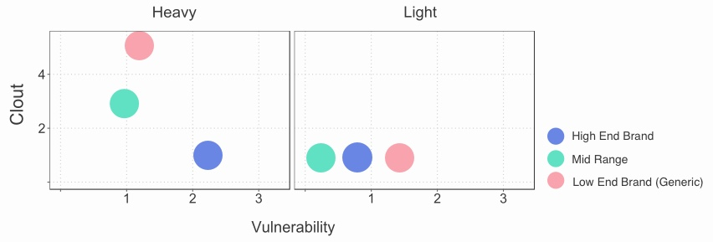
Price Sensitivity – Clout and Vulnerability
Heavy consumer
Light consumer
Heavy consumers are more price sensitive.
Brands have similar profiles for light users.

Slide 5

They exhibit different buying behaviours…

Slide 6
Buying behaviours
Importance
0
25
Promotion responsiveness (Price)
Maximum spend per visit
Average packs per visit
Average spend per visit
Average weekly visits
Minimum spend
Brand loyalty
Promotion responsiveness (Units)
Store loyalty

Slide 7
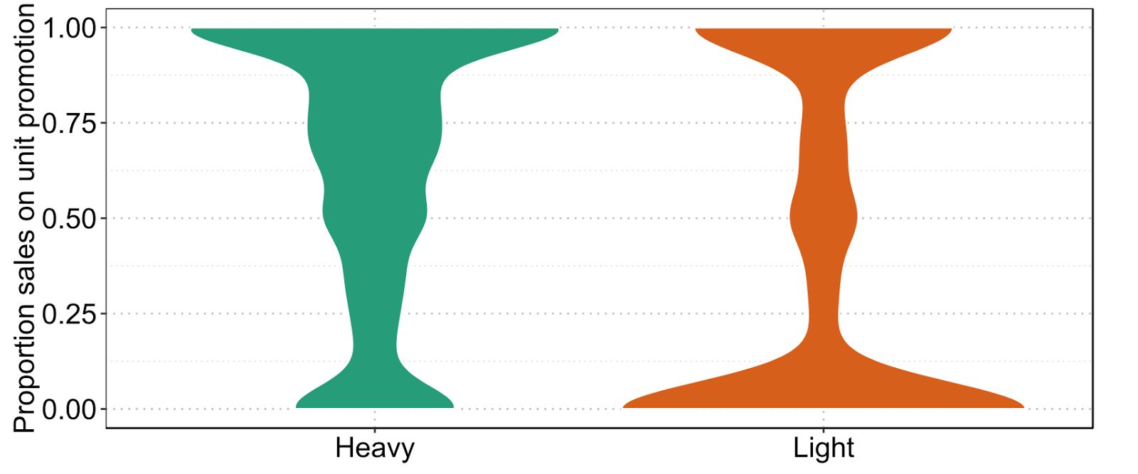
Promotions are the key to unlock the heavy consumer segment potential
100
Heavy consumer
75
Light consumer
Sales on unit promotion [%]
50
25
0

Slide 8
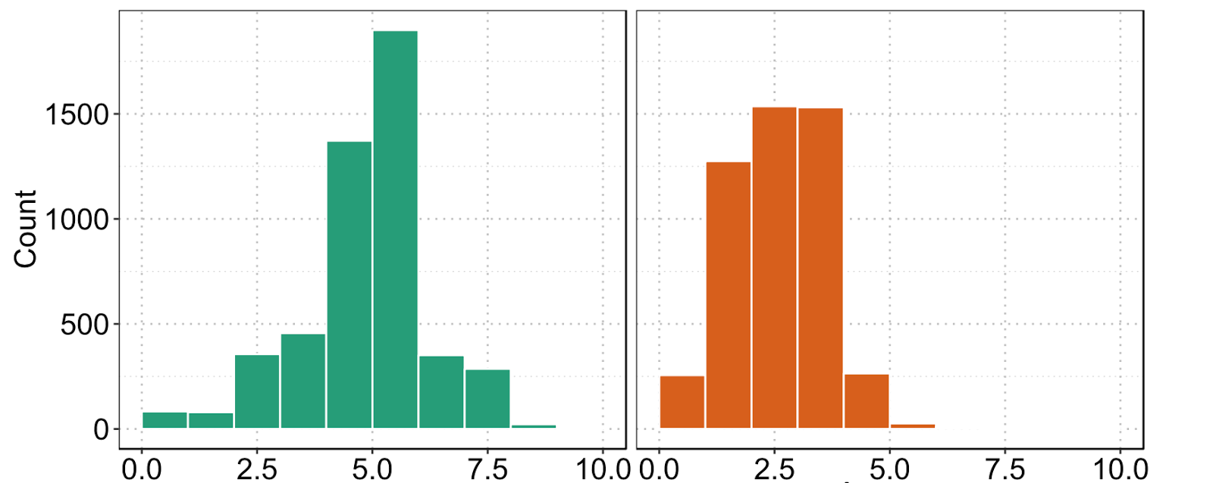
Heavy consumers spend significantly more on a shopping trip than light consumers
Purchasing behaviour – Spend
Heavy consumer
1,500
Light consumer
Number of households
1,000
500
0
0.0
2.5
5.0
7.5
10.0
0.0
2.5
5.0
7.5
10.0
Maximum spend in any single trip [GBP]

Slide 9
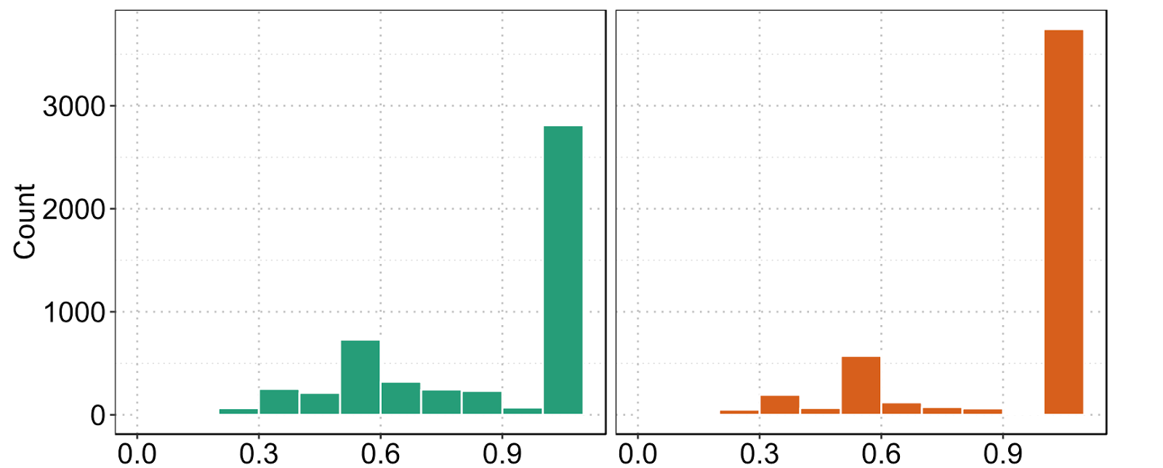
Heavy consumers are less loyal to brands and stores
Purchasing behaviour - Loyalty
Heavy consumer
1,500
Light consumer
Number of households
1,000
500
0
0.0
0.3
0.6
0.9
0.0
0.3
0.6
0.9
Brand loyalty [Herfindahl]

Slide 10
Recommendations
Heavy consumer
Light consumer
~ 40% more price sensitive
Responsive to promotions
Low volumes / total spending
More brand loyal

Slide 11
Recommendations
Heavy
Light
Value
Product standardisation
Branding campaigns
- Differentiation
- CSR
Size
Promotion
Distribution
Limited time coupons with each product purchased
Increase product variety

